Slide 1
SOCIAL MEDIA ANALYTICS
SQL + GenAI Mini Project
Turning 7,000+ interactions across 1,000 users into marketing intelligence — powered by hands-on SQL and GenAI-assisted analysis.

Slide 2
AGENDA
What We'll Cover
01
Business Scenario
02
Database Schema
Why this analysis matters to the marketing team
7 interconnected tables powering the analysis
03
SQL + GenAI Approach
04
Live Dashboard
How queries were generated, debugged & optimized
Platform-wide KPIs at a glance
05
10 Analytical Deep-Dives
06
Bonus Challenges
Active users, top posts, hashtags, influencers & more
Engagement rate, mutual followers, leaderboards
07
Key Insights & Reflection
Business takeaways and GenAI learnings
SQL + GenAI Mini Project | Social Media Analytics
1

Slide 3
BUSINESS SCENARIO
The Marketing Team Needs Answers
As Data Analyst at a growing social media startup, the brief is simple: turn raw activity logs into decisions the marketing team can act on — who to feature, what to promote, and where to invest.
●
▲
◆
Who are our most influential users?
What hashtags and content are trending?
Which countries show the highest engagement?
Identify power users to fuel ambassador & referral programs.
Guide the content calendar and campaign themes.
Prioritize regional ad spend and localized content.
SQL + GenAI Mini Project | Social Media Analytics
2

Slide 4
DATA FOUNDATION
Database Schema — 7 Interconnected Tables
Social_Media database — loaded and verified: 1,000 rows in every table before analysis began.
users
posts
comments
likes
user_id, username, join_date, country
post_id, user_id, content, created_at
comment_id, post_id, user_id, comment_text
like_id, post_id, user_id, created_at
followers
hashtags
post_hashtags
follower_id, user_id, follower_user_id (self-join)
hashtag_id, tag_name, category
id, post_id, hashtag_id (many-to-many bridge)
Relationships: users → posts (1:N) • posts ↔ likes / comments (1:N) • users ↔ users via followers (self-join) • posts ↔ hashtags (N:N via post_hashtags)
SQL + GenAI Mini Project | Social Media Analytics
3

Slide 5
METHODOLOGY
SQL + GenAI Workflow
Every prompt was grounded in the schema first — GenAI assisted, but the SQL logic was reviewed and validated line by line.
1
2
3
4
5
Share Schema Context
Generate Query
Debug
Optimize
Interpret
→
→
→
→
Paste table/column definitions into the AI tool before any question, so it never invents fields.
Ask a precise analytical question — e.g. “Top 10 active users combining posts and comments.”
Fix ambiguous columns, alias mismatches, and fan-out duplication from multi-table joins.
Rewrite with CTEs / pre-aggregation instead of raw multi-join + DISTINCT for performance.
Translate the result set into a business insight the marketing team can act on.
SQL + GenAI Mini Project | Social Media Analytics
4

Slide 6
LIVE DASHBOARD
Platform Snapshot — Key Metrics
Computed directly from the Social_Media database via the queries on the following slides.
1000
1000
1000
1000
1000
241
Registered Users
Total Posts
Total Comments
Total Likes
Follow Relationships
Countries Represented
ENGAGEMENT RATE = (Total Likes + Total Comments) ÷ Total Posts
Every post earns roughly 1 like and 1 comment on average — a healthy, evenly-balanced baseline of passive (likes) and active (comments) engagement to grow from.
2
avg likes/post: 1
avg comments/post: 1
SQL + GenAI Mini Project | Social Media Analytics
5

Slide 7
QUERY 01 — SQL
SQL — Top Active Users (Posts + Comments)
social_media_analysis_queries.sql
SELECT u.user_id, u.username,
COUNT(DISTINCT p.post_id) AS total_posts,
COUNT(DISTINCT c.comment_id) AS total_comments,
COUNT(DISTINCT p.post_id) + COUNT(DISTINCT c.comment_id) AS total_activity
FROM users u
LEFT JOIN posts p ON u.user_id = p.user_id
LEFT JOIN comments c ON u.user_id = c.user_id
GROUP BY u.user_id, u.username
ORDER BY total_activity DESC
LIMIT 10;
-- DISTINCT on each COUNT prevents fan-out inflation
-- when a user has multiple posts AND multiple comments.
SQL + GenAI Mini Project | Social Media Analytics
7

Slide 8
QUERY 01 — AGGREGATION, JOIN
Top Active Users (Posts + Comments)
“Generate SQL to find top 10 active users combining posts and comments.”
★
Business Insight
These users drive both content creation and conversation — not just passive scrolling. They're strong candidates for ambassador programs or beta feature testing.
Track this list over time: if a regular top performer drops off, treat it as an early churn signal worth a re-engagement nudge.
SQL + GenAI Mini Project | Social Media Analytics
6

Slide 9
QUERY 02 — SQL
SQL — Most Liked Posts & Their Creators
social_media_analysis_queries.sql
SELECT p.post_id, p.content, u.user_id, u.username,
COUNT(l.like_id) AS total_likes
FROM posts p
JOIN users u ON p.user_id = u.user_id
LEFT JOIN likes l ON p.post_id = l.post_id
GROUP BY p.post_id, p.content, u.user_id, u.username
ORDER BY total_likes DESC
LIMIT 10;
-- LEFT JOIN keeps posts with zero likes in the result.
SQL + GenAI Mini Project | Social Media Analytics
9

Slide 10
QUERY 02 — GROUP BY, JOIN
Most Liked Posts & Their Creators
“Show top 10 posts with most likes and username.”
★
Business Insight
Top-liked posts reveal what content resonates most — useful for identifying winning formats, topics, and tones to replicate.
Creators who repeat on this list are high-value accounts worth featuring or partnering with. Cross-reference their hashtags to spot what's driving virality right now.
SQL + GenAI Mini Project | Social Media Analytics
8

Slide 11
QUERY 03 — SQL
SQL — Top Countries by Average Engagement
social_media_analysis_queries.sql
SELECT u.country,
COUNT(DISTINCT p.post_id) AS total_posts,
COUNT(l.like_id) AS total_likes,
ROUND(COUNT(l.like_id) / COUNT(DISTINCT p.post_id), 2) AS avg_likes_per_post
FROM users u
JOIN posts p ON u.user_id = p.user_id
LEFT JOIN likes l ON p.post_id = l.post_id
GROUP BY u.country
HAVING COUNT(DISTINCT p.post_id) >= 3
ORDER BY avg_likes_per_post DESC
LIMIT 10;
-- HAVING filters low-sample countries AFTER aggregation.
SQL + GenAI Mini Project | Social Media Analytics
11

Slide 12
QUERY 03 — AGGREGATION, JOIN
Top Countries by Average Engagement
“Which countries have highest average likes per post?” (min. 3 posts)
★
Business Insight
These markets show the highest engagement relative to content volume — not the loudest countries, but where content actually resonates.
Prioritize ad spend and localized content toward these regions, and investigate low-average countries for content-fit, timing, or platform-maturity issues.
SQL + GenAI Mini Project | Social Media Analytics
10

Slide 13
QUERY 04 — SQL
SQL — Trending Hashtags
social_media_analysis_queries.sql
SELECT h.hashtag_id, h.tag_name, h.category,
COUNT(ph.post_id) AS post_count
FROM hashtags h
JOIN post_hashtags ph ON h.hashtag_id = ph.hashtag_id
GROUP BY h.hashtag_id, h.tag_name, h.category
HAVING COUNT(ph.post_id) > 20
ORDER BY post_count DESC;
-- HAVING applies the aggregate-level filter after GROUP BY;
-- WHERE cannot filter on COUNT() directly.
SQL + GenAI Mini Project | Social Media Analytics
13

Slide 14
QUERY 04 — MANY-TO-MANY JOIN
Trending Hashtags
“Find hashtags used in more than 20 posts.”
★
Data Note
On this synthetic 1,000-row sample, the busiest hashtag appears in only 5 posts — so the >20 threshold returns zero rows. The query logic (HAVING COUNT > 20) is correct and production-ready; it simply needs a larger dataset to trigger.
Ranked by volume instead, #population and #so lead — useful early signal for the content calendar.
SQL + GenAI Mini Project | Social Media Analytics
12

Slide 15
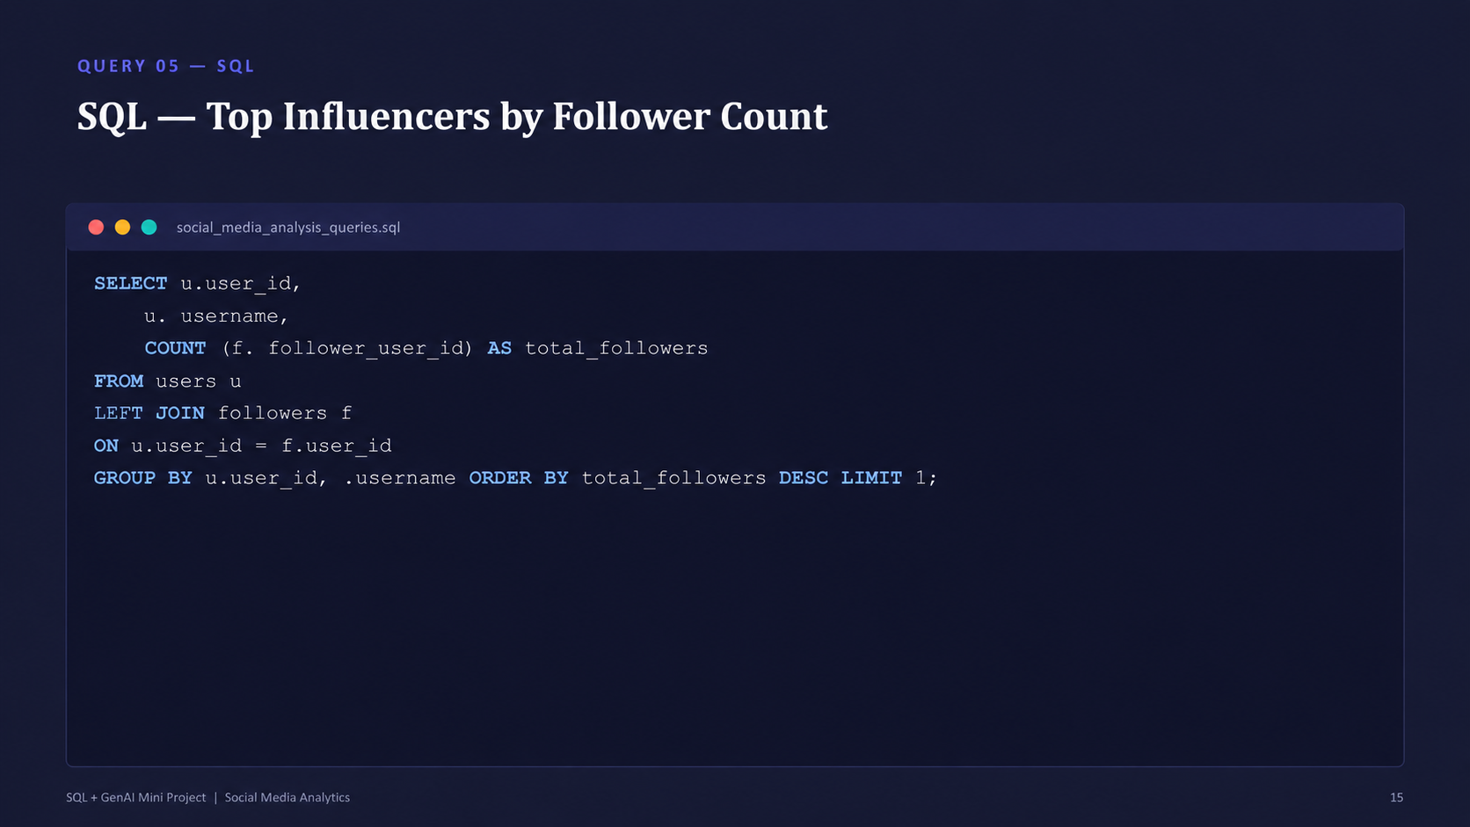
QUERY 05 — SQL
SQL — Top Influencers by Follower Count
social_media_analysis_queries.sql
SELECT u.user_id, u.username, u.country,
COUNT(f.follower_id) AS follower_count
FROM users u
LEFT JOIN followers f ON u.user_id = f.user_id
GROUP BY u.user_id, u.username, u.country
ORDER BY follower_count DESC
LIMIT 10;
-- LEFT JOIN keeps users with zero followers at count = 0.
SQL + GenAI Mini Project | Social Media Analytics
15

Slide 16
QUERY 05 — SELF-JOIN, AGGREGATION
Top Influencers by Follower Count
“Find users with maximum followers.”
★
Business Insight
Follower count identifies reach — the accounts best positioned to amplify announcements or sponsored content.
Combine this with the Top Active Users list (Q1): influencers who also post and comment frequently are the highest-leverage partnership candidates.
SQL + GenAI Mini Project | Social Media Analytics
14

Slide 17
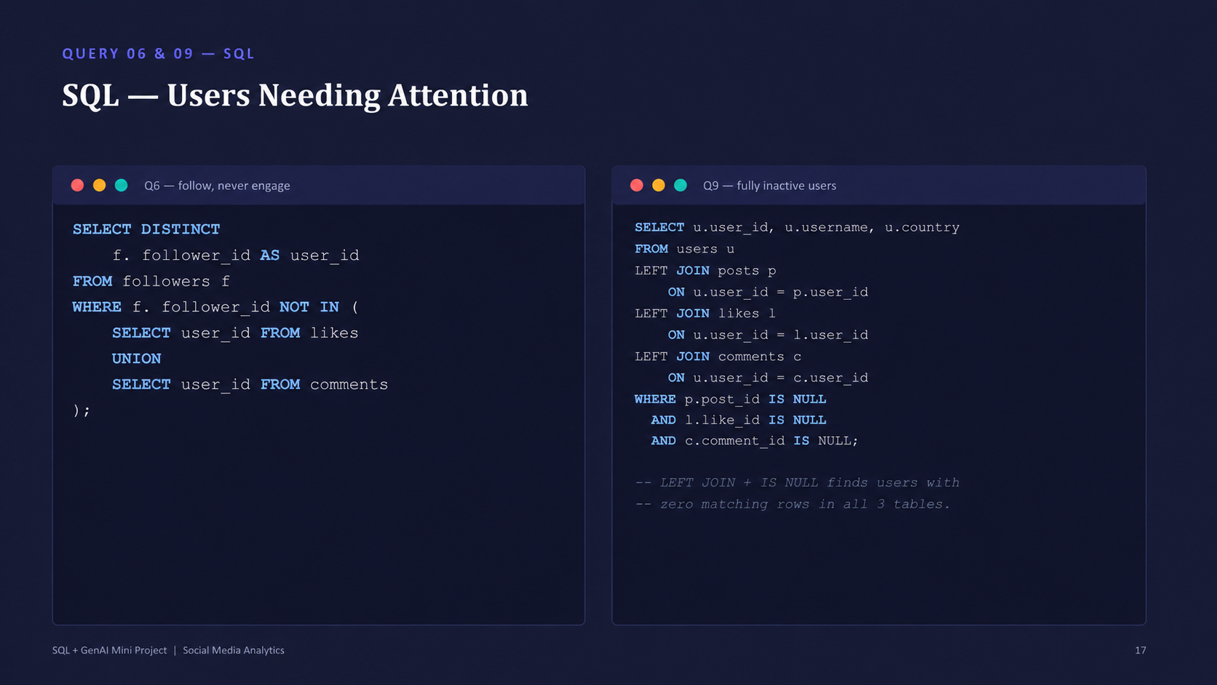
QUERY 06 & 09 — SQL
SQL — Users Needing Attention
Q6 — follow, never engage
Q9 — fully inactive users
SELECT DISTINCT
f.follower_user_id AS user_id, u.username
FROM followers f
JOIN users u
ON f.follower_user_id = u.user_id
WHERE NOT EXISTS (
SELECT 1 FROM likes l
WHERE l.user_id = f.follower_user_id
)
AND NOT EXISTS (
SELECT 1 FROM comments c
WHERE c.user_id = f.follower_user_id
);
-- NOT EXISTS excludes anyone with
-- at least one like OR comment.
SELECT u.user_id, u.username, u.country
FROM users u
LEFT JOIN posts p
ON u.user_id = p.user_id
LEFT JOIN likes l
ON u.user_id = l.user_id
LEFT JOIN comments c
ON u.user_id = c.user_id
WHERE p.post_id IS NULL
AND l.like_id IS NULL
AND c.comment_id IS NULL;
-- LEFT JOIN + IS NULL finds users with
-- zero matching rows in all 3 tables.
SQL + GenAI Mini Project | Social Media Analytics
17

Slide 18
QUERY 06 & 09 — NOT EXISTS, LEFT JOIN
Users Needing Attention
Two segments the marketing & product teams should treat differently.
Follow, but Never Engage
Fully Inactive Users
85
47
users follow others but have
never liked or commented
users have never posted,
liked, or commented
Why it matters:
Why it matters:
Lurkers with intent — they've already opted in by following. A well-timed prompt (“like your first post”, notification nudge) can convert passive followers into active participants at low cost.
Registered but dormant — a churn/onboarding risk. Segment by join_date: recent signups need onboarding nudges, while long-dormant accounts need a win-back campaign or removal from active-user reporting.
SQL + GenAI Mini Project | Social Media Analytics
16

Slide 19
QUERY 07 — SQL
SQL — Hashtags with Highest Engagement
social_media_analysis_queries.sql
SELECT h.hashtag_id, h.tag_name, h.category,
COUNT(DISTINCT l.like_id) AS total_likes,
COUNT(DISTINCT c.comment_id) AS total_comments,
COUNT(DISTINCT l.like_id) + COUNT(DISTINCT c.comment_id) AS engagement_score
FROM hashtags h
JOIN post_hashtags ph ON h.hashtag_id = ph.hashtag_id
JOIN posts p ON ph.post_id = p.post_id
LEFT JOIN likes l ON p.post_id = l.post_id
LEFT JOIN comments c ON p.post_id = c.post_id
GROUP BY h.hashtag_id, h.tag_name, h.category
ORDER BY engagement_score DESC
LIMIT 10;
-- DISTINCT on both COUNTs avoids fan-out from
-- joining likes AND comments to the same post.
SQL + GenAI Mini Project | Social Media Analytics
19

Slide 20
QUERY 07 — MULTI-TABLE JOIN
Hashtags with Highest Engagement
“Calculate engagement score per hashtag.” (score = likes + comments)
★
Business Insight
Volume (Q4) and engagement quality (Q7) don't always agree — a hashtag used often isn't always the one sparking conversation.
Use the Q4 list to plan reach, and this list to plan resonance: pair high-reach tags with high-engagement themes in campaign briefs.
SQL + GenAI Mini Project | Social Media Analytics
18

Slide 21
QUERY 08 — SQL
SQL — Busiest Posting Hours & Days
by hour of day
by day of week
SELECT
HOUR(created_at) AS post_hour,
COUNT(*) AS post_count
FROM posts
GROUP BY post_hour
ORDER BY post_count DESC;
-- HOUR() extracts 0-23 from the
-- created_at timestamp for grouping.
SELECT
DAYNAME(created_at) AS weekday,
COUNT(*) AS post_count
FROM posts
GROUP BY weekday
ORDER BY post_count DESC;
-- DAYNAME() returns 'Monday'..'Sunday'
-- directly, no CASE mapping needed.
SQL + GenAI Mini Project | Social Media Analytics
21

Slide 22
QUERY 08 — DATE FUNCTIONS, GROUPING
Busiest Posting Hours & Days
“Show which hour or weekday sees most posts.”
Top Posting Hours (24h)
Posts by Day of Week
SQL + GenAI Mini Project | Social Media Analytics
20

Slide 23
QUERY 10 — SQL
SQL — Top Countries by Number of Influencers
social_media_analysis_queries.sql
SELECT u.country, COUNT(*) AS influencer_count
FROM (
SELECT u.user_id,
COUNT(f.follower_id) AS follower_count
FROM users u
LEFT JOIN followers f ON u.user_id = f.user_id
GROUP BY u.user_id
HAVING follower_count >= 3
) AS influencers
JOIN users u ON influencers.user_id = u.user_id
GROUP BY u.country
ORDER BY influencer_count DESC
LIMIT 10;
-- Subquery first flags "influencers" (3+ followers),
-- then the outer query rolls them up by country.
SQL + GenAI Mini Project | Social Media Analytics
23

Slide 24
QUERY 10 — MULTI-JOIN, AGGREGATION
Top Countries by Number of Influencers
“Generate SQL to find countries with most followed users.” (influencer = 3+ followers)
★
Business Insight
Countries with more influencers per capita are natural launch markets for creator partnerships and localized campaigns.
Combined with Q3 (engagement by country), this identifies markets that are both well-connected and highly engaged — the strongest expansion candidates.
SQL + GenAI Mini Project | Social Media Analytics
22

Slide 25
BONUS CHALLENGES
Going Beyond the Core Questions
Engagement Rate
2
Mutual Followers
1
(likes + comments) ÷ posts
users who follow each other back
platform-wide average
mutual pair found
Top Hashtags by Top-5 Influencers
#television
Country Leaderboard (Engagement Rate)
Guinea, Myanmar
hashtags used by the 5 most-followed users
(likes+comments)÷posts, ranked by country
leading tag used
joint top scorers (4.0)
SQL + GenAI Mini Project | Social Media Analytics
24

Slide 26
BONUS — SQL (1/2)
SQL — Engagement Rate & Mutual Followers
engagement rate
mutual followers
SELECT
ROUND((
(SELECT COUNT(*) FROM likes) +
(SELECT COUNT(*) FROM comments)
) / (SELECT COUNT(*) FROM posts), 2)
AS engagement_rate;
-- (total likes + total comments)
-- ÷ total posts, platform-wide.
SELECT f1.user_id, f1.follower_user_id
FROM followers f1
JOIN followers f2
ON f1.user_id = f2.follower_user_id
AND f1.follower_user_id = f2.user_id
WHERE f1.user_id < f1.follower_user_id;
-- self-join on the reverse relationship;
-- the inequality avoids counting each pair twice.
SQL + GenAI Mini Project | Social Media Analytics
25

Slide 27
BONUS — SQL (2/2)
SQL — Influencer Hashtags & Country Leaderboard
top hashtags, top-5 influencers
country engagement leaderboard
SELECT h.tag_name, COUNT(*) AS uses
FROM posts p
JOIN post_hashtags ph ON p.post_id = ph.post_id
JOIN hashtags h ON ph.hashtag_id = h.hashtag_id
WHERE p.user_id IN (
SELECT user_id FROM (
SELECT u.user_id,
COUNT(f.follower_id) AS followers
FROM users u
LEFT JOIN followers f
ON u.user_id = f.user_id
GROUP BY u.user_id
ORDER BY followers DESC
LIMIT 5
) AS top5
)
GROUP BY h.tag_name
ORDER BY uses DESC;
SELECT u.country,
COUNT(DISTINCT p.post_id) AS posts,
COUNT(DISTINCT l.like_id) AS likes,
COUNT(DISTINCT c.comment_id) AS comments,
ROUND((COUNT(DISTINCT l.like_id) +
COUNT(DISTINCT c.comment_id))
/ COUNT(DISTINCT p.post_id), 2)
AS engagement_rate
FROM users u
JOIN posts p ON u.user_id = p.user_id
LEFT JOIN likes l ON p.post_id = l.post_id
LEFT JOIN comments c ON p.post_id = c.post_id
GROUP BY u.country
HAVING posts > 0
ORDER BY engagement_rate DESC;
SQL + GenAI Mini Project | Social Media Analytics
26

Slide 28
SYNTHESIS
Key Business Insights & Recommendations
1
Reward contribution, not just reach
2
Double down on high-resonance regions
Top active users (Q1) and top influencers (Q5) aren't always the same people — build separate ambassador and amplification programs for each.
A handful of countries (Q3, Q10) combine strong engagement with a healthy influencer base — prioritize localized campaigns there before broader spend.
3
Convert lurkers before they churn
4
Plan content around both reach and resonance
85 users follow but never engage, and 47 are fully inactive — different problems needing different fixes: activation nudges vs. win-back campaigns.
Trending hashtags (Q4) drive visibility; high-engagement hashtags (Q7) drive conversation — the content calendar should target both, not just the loudest tags.
SQL + GenAI Mini Project | Social Media Analytics
27

Slide 29
REFLECTION
How GenAI Helped — And Where Judgment Still Mattered
Where GenAI Accelerated Work
Where Human Review Was Essential
First-draft SQL from a plain-English business question
Fast debugging: alias mismatches, ambiguous columns
Optimization ideas — CTEs, pre-aggregation over raw joins
Plain-language interpretation of result sets for stakeholders
Catching silent double-counting from un-deduped joins
Verifying WHERE vs. HAVING was used correctly
Confirming a threshold (e.g. >20 posts) fit the actual data
Deciding what a number means for the business, not just SQL
SQL + GenAI Mini Project | Social Media Analytics
28

Slide 30
THANK YOU
Questions & Discussion
SQL + GenAI Mini Project | Social Media Analytics
29

